Slide 1
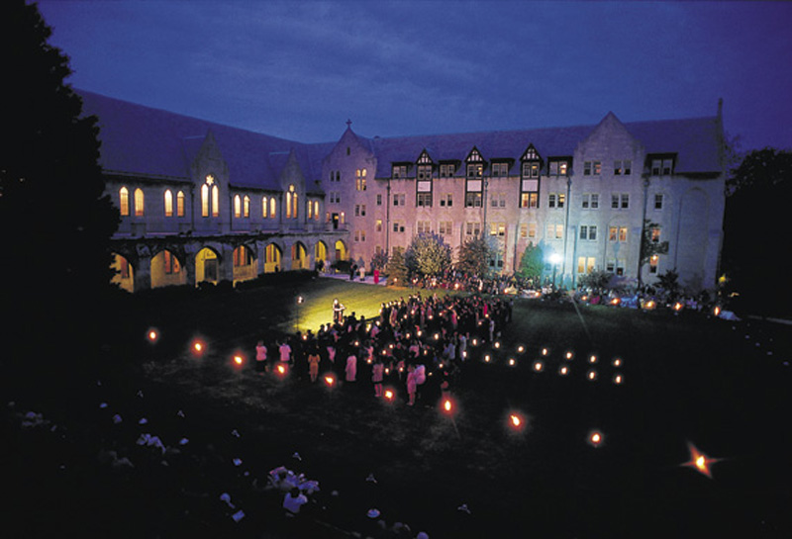
Registration
Dominican University Peer Advisors

Slide 2
Basic Academic Requirements

Slide 3
Foundation Requirements
English 102
Information Access Workshop
Math (130,150, 160, or 170)
Language (through 102)
CIS 120
Seminars

Slide 4
Area Studies
History
Literature
Fine Arts
Natural Science
Philosophy
Social Sciences
Theology
Multicultural

Slide 5
MyDU
Logging in/how to register
Looking up classes
Dates
Times
Sections
How to look for area studies
Peer Advising Page
Advising Worksheets

Slide 6
Bulletin
What does it provide?
Descriptions of majors, minors, and courses.
Opportunity to create your profile to monitor your progress.
Lists of prerequisites for courses.
Details about rules, regulations and policies at DU.
Always follow the year you came in under (2014-2015 if you’re a freshmen right now)

Slide 7
Registration Dates
Advanced Registration
Begins November 11th
Freshmen Registration
November 14th

Slide 8
Questions?

