Slide 1
15 Tips on How to Study in College and Where to Study @DU
Freshman Seminar Series

Slide 2
1. Engage Your Professors
Questions about the assignments
Go to office hours
Talk to your professor before/after class
Send emails
2. Take Effective Notes
Always take notes for a particular class in the same notebook
Anything your professor writes on the board should appear in your notes

Slide 3
3. Plan Ahead
Divide readings up into manageable chunks (don’t read 200 pages at one time; you will not retain anything!)
Study for Quizzes and Tests over the course of a week
Start thinking of ideas for papers when the assignment is given

Slide 4
4. Open To Feedback
Go over mistakes on exams and assignments
Review professor’s remarks
5. Be Involved in your classes
Ask questions
Participate

Slide 5
6. Manage Your Surroundings
It is hard to do work without the right tools
Computer, printer
Materials for the course
Lecture Notes, textbook, handouts and assignment
7. Don’t Kid Yourself
Don’t say you are studying when you’re really checking your Facebook

Slide 6
8. Manage Your Feelings
It’s difficult to excel if you’re feeling doomed to fail
Focus on your positive achievements
9. Keep Yourself in Tip-Top Shape
Never underestimate the value of sleeping and eating right

Slide 7
10. Challenge Yourself
Think actively about what your reading
Don’t zone out or text when in class
11. Be Persistent
Course work is tough
Extra work may be needed for some assignments

Slide 8
12. Don’t Cut Corners
Stay on top of your work
Focus on important tasks you need to get done
13. Aim High
(or at least a decent level)
Never strive for average

Slide 9
14. Look Out For No. 1
Successful students know that college is their job and make doing well their highest priority
15. Visualize Success
It helps to achieve a goal if you visualize yourself achieving it

Slide 10
Places to Study on Campus!
The Reading Room
Cyber
The Tech Lab
Academic Enrichment Center
The Dining Hall
The Library
The “L”
The Underground

Slide 11
The Reading Room
Very Quiet
Dim lighting
Limited talking
Open 24 hours
Hard to get Wi-Fi (can be a positive & negative)
Comfortable Chairs
You may end up taking a NAP!
Located on the 2nd Floor of Lewis

Slide 12
Cyber
Internet access
Computers available
Accessible to food
A lot of seating area
Can get really loud during meal exchange hours
TVs are on all the time
Limited outlets

Slide 13
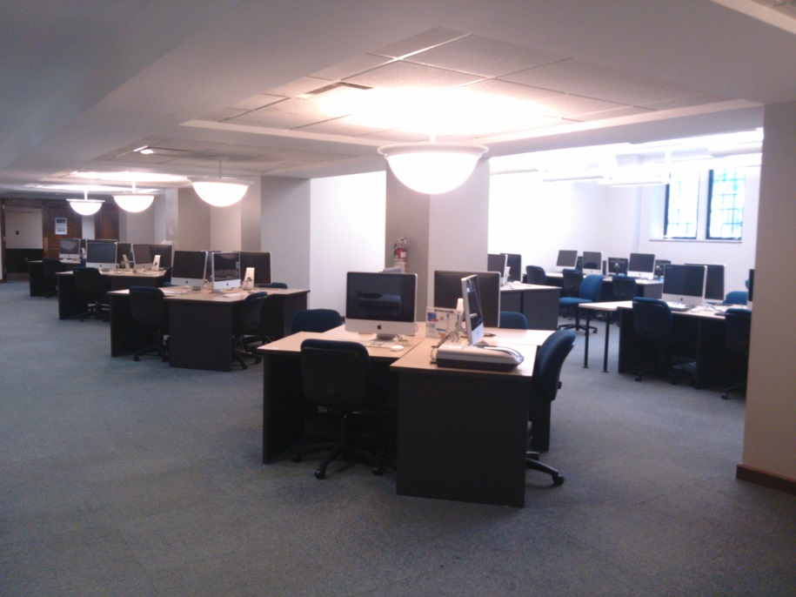
The Tech Lab
Nice computers
Pretty silent
Gets really hot there
Open 24 hours (Finals Week)
Lower Level of Lewis Hall

Slide 14
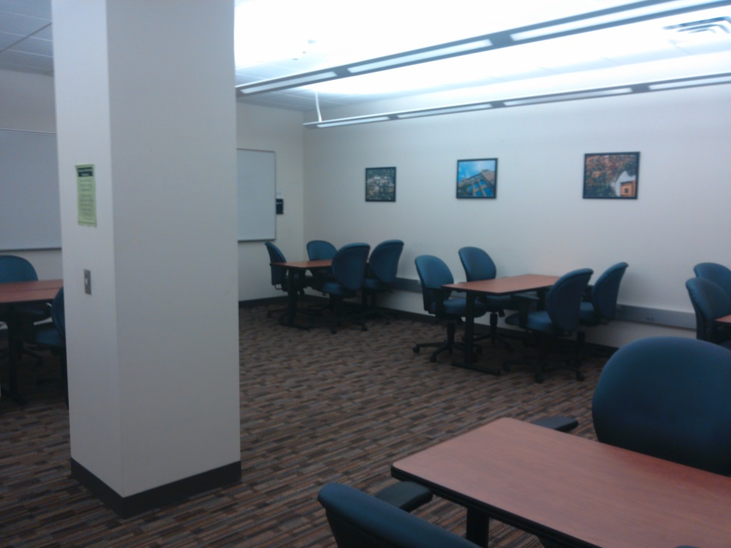
Academic Enrichment Center
Review Papers
Tutoring
Appointment Needed
dom.mywconline.com
Lower Level Parmer Hall

Slide 15
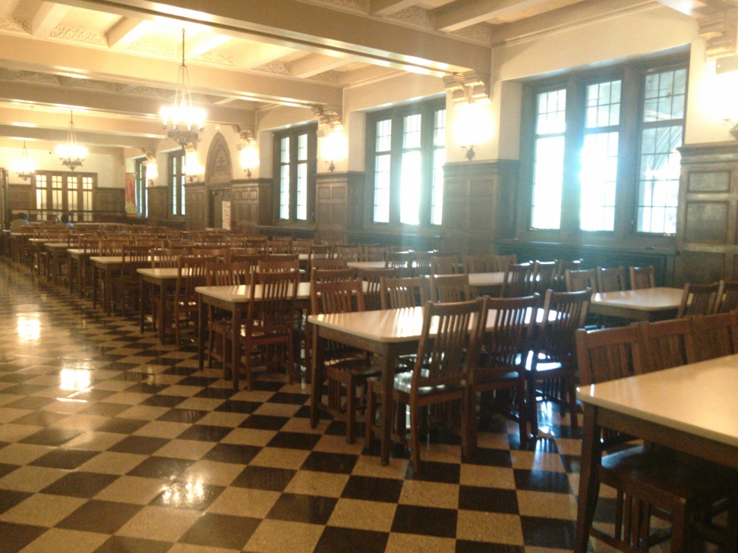
The Dinning Hall
Not used at night
A lot of space
Great for study groups
Limited access to Wi-Fi

Slide 16
The Library
A lot of computers available.
You can find many books for papers
Quiet in certain areas
But a lot of traffic noise around staircases
Small desk in back corners by windows
Closes at 12am

Slide 17
The “L”
Has Wi-Fi
Computers near by
Near vending machines, fridge, water dispenser, and a microwave
People are usually watching television
Open 24hrs. Just call security to open front door of Lewis
Located in the back of Power

Slide 18
The Underground
Has Wi-fi
Outlets only on far ends of the room
Is quiet but not as quiet as the Reading room
Open until around 10:30
Not many people use it
Away from everyone
Located underneath the “L”. Can be accessed from the tunnels.

